Slide 1
This is a hidden slide
Dear honorable teacher please follow the instructions that has given in the slide notes (under the every slide). It would be helpful to take a successful class. Thanks a lot. I wish you good luck.

Slide 2

WELCOME
Notes:
Teacher can say it orally.

Slide 3

Identity
S.K.Md. Harunar Rashid
- Senior Assistant Teacher
Sonatola Model High School
Bogra.
English For Today
Class : Six.
Lesson 8
Notes:
Teacher can hide this slide.

Slide 4
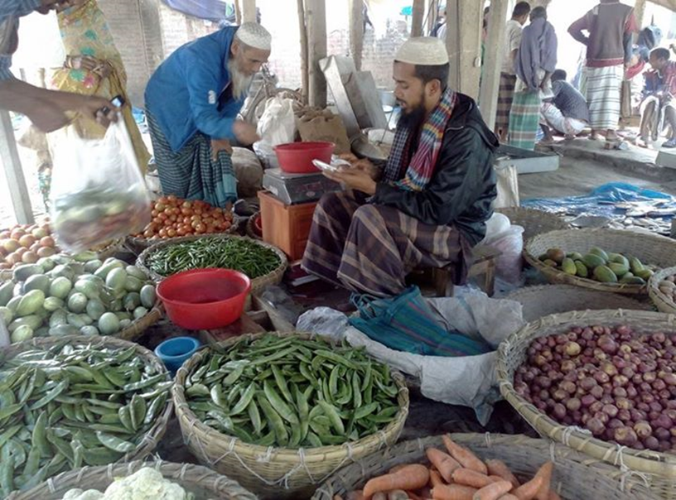

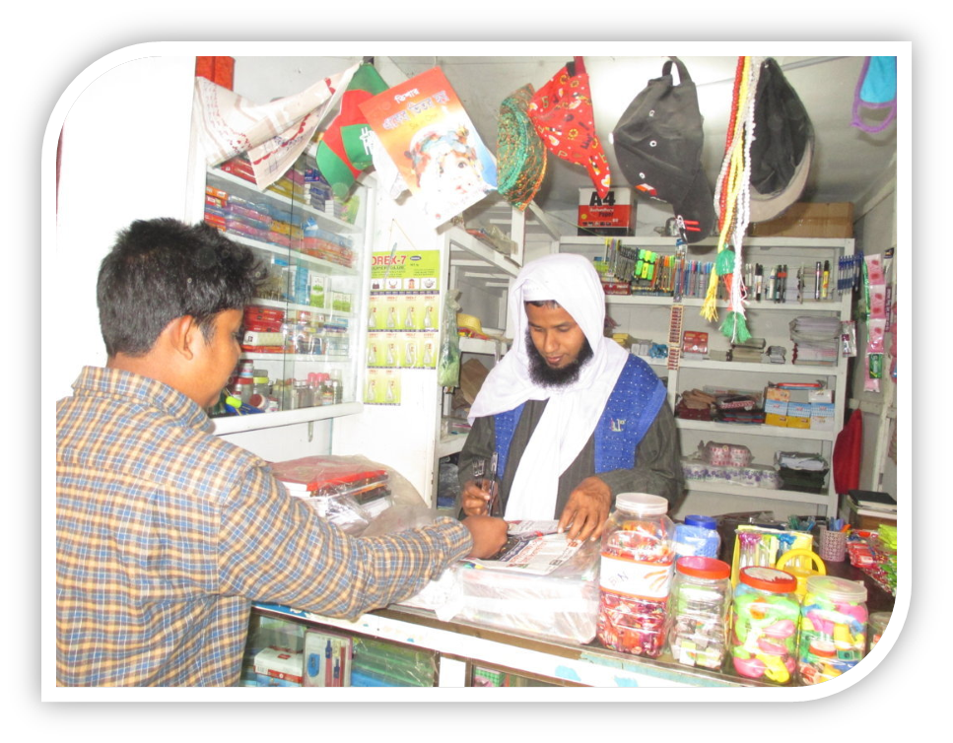
Look at the pictures and guess What they are doing.
They are shopping.
Notes:
After showing the pictures T will ask and try to elicit the answer from the students. If they fail then T will give feedback by clicking.

Slide 5
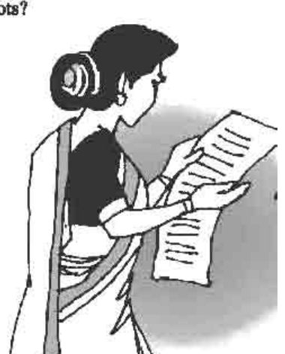
Today`s topic
Grocery Shopping
Lesson: 8(1)

Slide 6
Learning outcomes
After completing the lesson students will be able to…
use word stress on words in sentences
Participate in short dialogues and conversations on familiar topics
read and understand texts
ask and answer questions
use `some’ and `any’ in sentence.

Slide 7
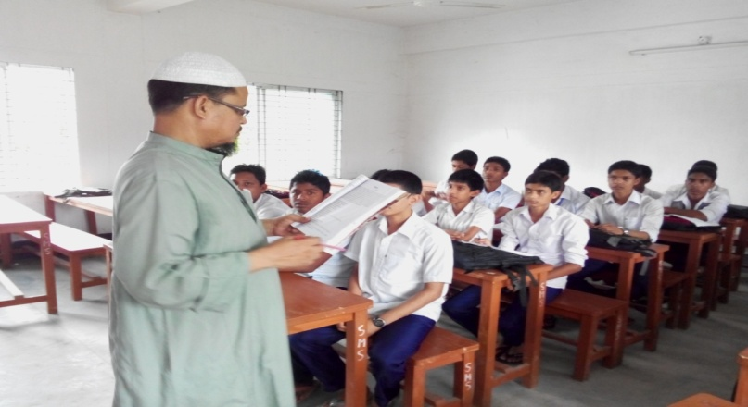
Model Reading (Pair works)
Listen the conversation between Imran and his mother then practice it in pair.
Notes:
Teacher will read the text proper way then he/she will ask his/her students to discuss with their pairs.

Slide 8
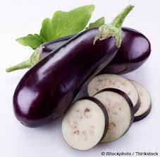


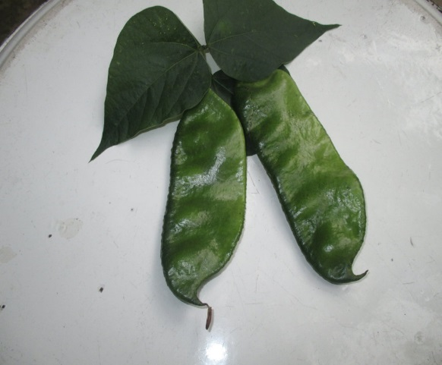

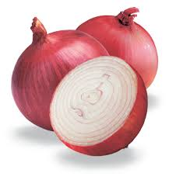
Look at the below pictures of vegetables and try to say theirs name.
Eggplant
Cucumber
Carrot
Bean
Cauliflower
Onion
Notes:
After showing the pictures T will ask and try to elicit the answer from the students. If they fail then T will give feedback by clicking.

Slide 9
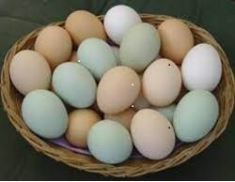


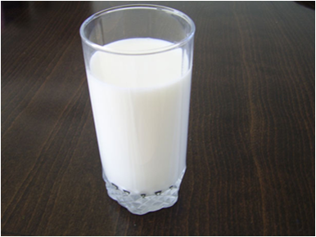
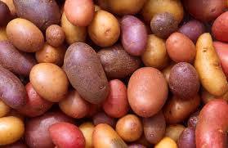
Imagine you are shopkeeper. What will you ask to your customers about below item`s quantity ? (using how much / how many.) one is done for you.
How many pen do you want ?
How much carrots do you want ?
Notes:
After showing the pictures T will ask and try to elicit the answer from the students. If they fail then T will give feedback by clicking.

Slide 10
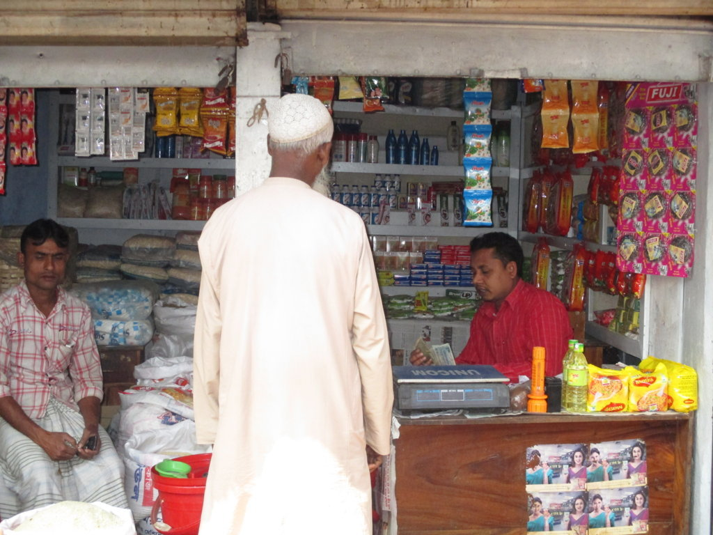
Use of ‘How much’
How much uses for uncountable noun :
Uncountable noun : That’s we can’t count : Such as – water, milk, sugar, oil, Gold etc.
How much sugar do you want ?
How much milk do you want ?
Structure : How much + noun + auxiliary verb + subject + main verb + ext ?
Notes:
Teacher will discuss : when we use how much and how many, countable and uncountable noun.

Slide 11
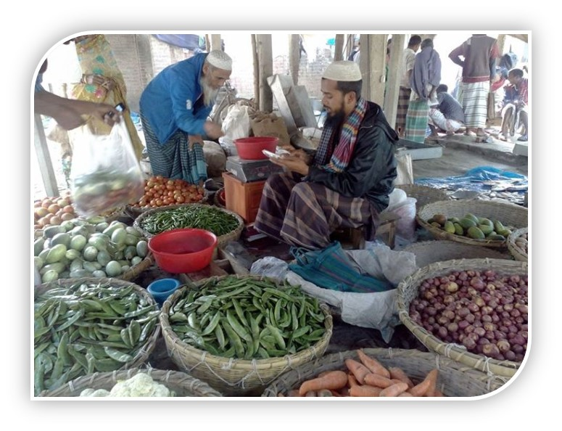
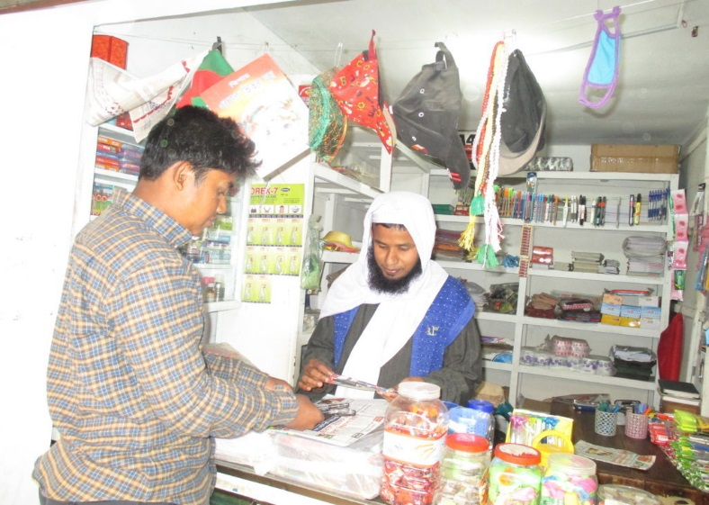
Use of ‘How many’
How many uses for countable noun :
Countable noun : That’s we can count : Such as – Pen, book, Egg, Chair, Table etc.
How many eggs do you want?
How many pen do you want ?
Structure : How many +noun + auxiliary verb + subject + main verb + ext ?
Notes:
Teacher will discuss : when we use how much and how many, countable and uncountable noun.

Slide 12
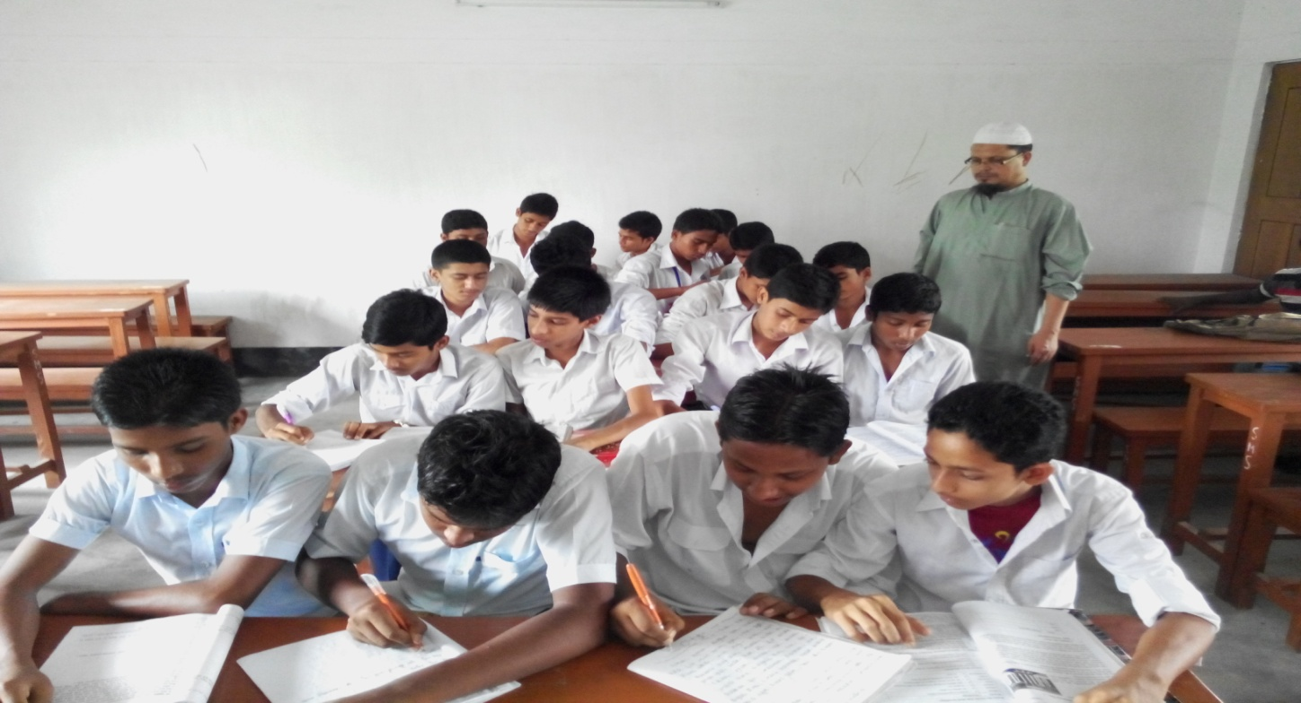
Silent reading (Pair works)
Go to section ‘B’ and read the dialogues then discuss the questions in pairs that have given in section ‘B1’.
Notes:
Teacher will monitor and help the students. Then will do the next task in next slide.

Slide 13
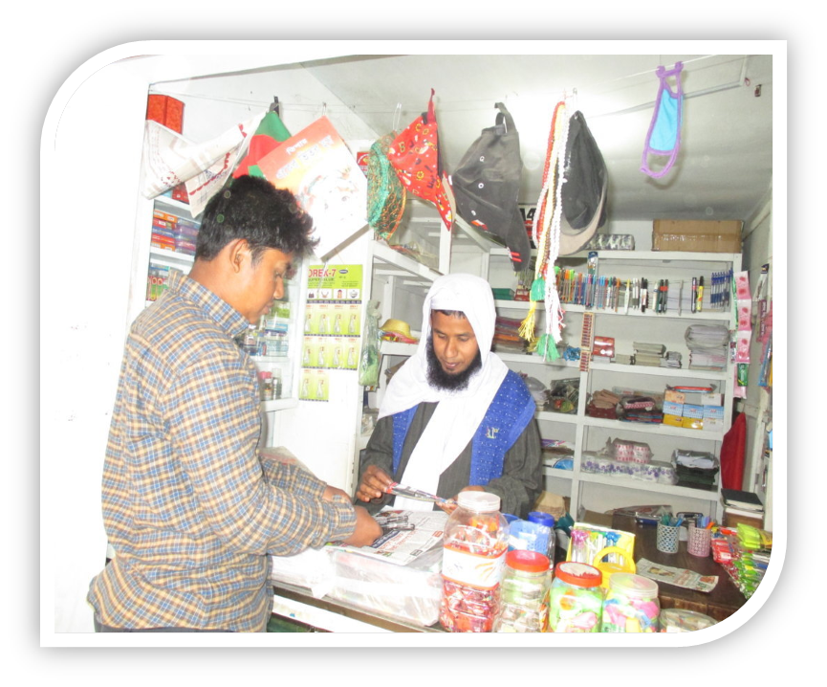
Now make pair with your friend beside you. Decide who is shopkeeper and who is customer then repeat the conversation
In the picture you can see a stationary shop. A boy has came to buy a pen.
I want to buy a pen
Here you are !
Yes, how can I help you ?
How much is it ?
Thank you !
Excuse me !
Sure ! There you go.
1o taka only.
Notes:
After showing the conversation. Every pair will act the conversation and teacher will help if needed and monitor the class.

Slide 14
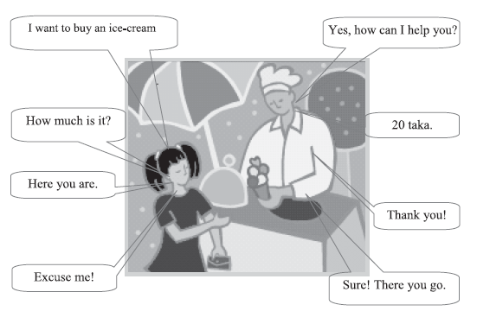
Individual Work
Now go to section ‘B2’. Look and read the sentences in the eight speech bubbles. Put them in the right order ( I to 8 ).
Notes:
Teacher can help the students. For feedback he/she will go to next slide.

Slide 15
Compare with your answer.
The girl: Excuse me.
The salesman: Yes, how can I help you?
The girl: I want to buy an ice-cream.
The Salesman: Sure! There you go.
The girl: How much is it?
The salesman: 20 taka.
The girl: Here you are.
The salesman: Thank you.
Notes:
This slide for feedback.

Slide 16
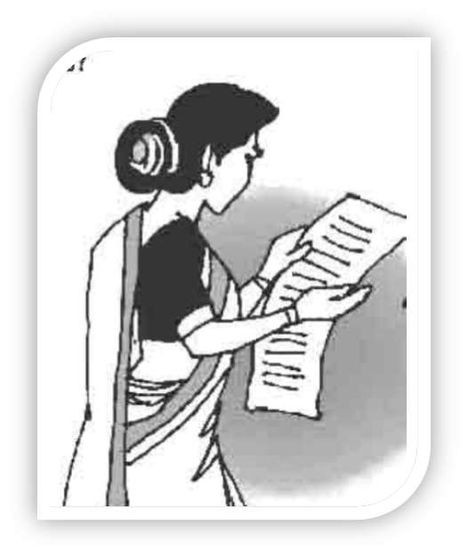

Home works.
Make a imaginary shopping list with quantity for grocer’s, baker’s and stationer`s.

Slide 17
Acknowledgement
We would like to express our cordial gratitude to the Ministry of Education, Directorate of Secondary & Higher Education, NCTB, a2i
and
the panel of honorable editors ( Md. Jahangir Hasan, Associate Professor (English) TTC, Rangpur, Ranjit Poddar, Associate Professor (English) TTC, Dhaka, and Urmila Ahmed, Associate Professor (English) TTC, Dhaka, to enrich the contents.

Slide 18

GOOD BYE
SEE
AGAIN
YOU
Notes:
Teacher can say it orally.

